Slide 1

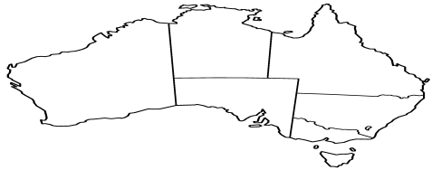
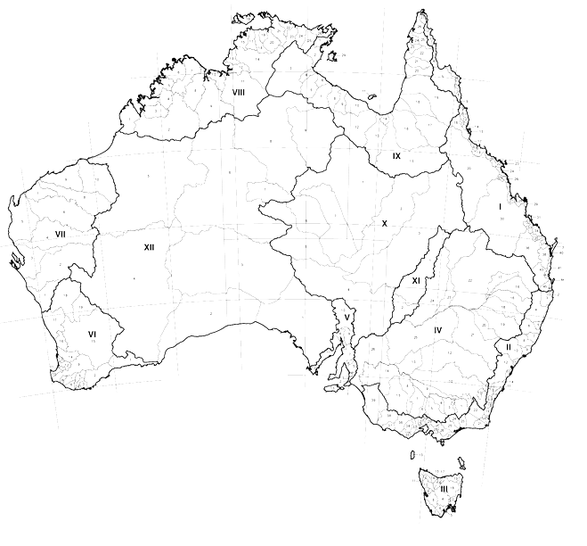
FSDF Server
http://envirohack.research.nicta.com.au/fsdf-topology/
Hierarchical Relationship:
- e.g., NSW (State) is parent to Corowa (LGA)
Jurisdictional Units
FSDF
Topology
Local Government Units
Spatial Relationship
– e.g. NSW (State) is “adjacent” to Berrigan (LGA)
Spatial Relationship
– e.g. Albury (LGA) “intersects” Lavingtion (SA2)
Statistical Units
ABS
PSMA
Geometry
Data
GeoServer
http://envirohack.research.nicta.com.au/

Slide 2
FSDF Server
Hierarchical Relationship:
- e.g., NSW (State) is parent to Corowa (LGA)
Jurisdictional Units
FSDF
Topology
Local Government Units
Spatial Relationship
– e.g. NSW (State) is “adjacent” to Berrigan (LGA)
Spatial Relationship
– e.g. Albury (LGA) “intersects” Lavingtion (SA2)
Statistical Units
ABS
Geometry
Data
GeoServer
(http://envirohack.research.nicta.com.au/)

Slide 3
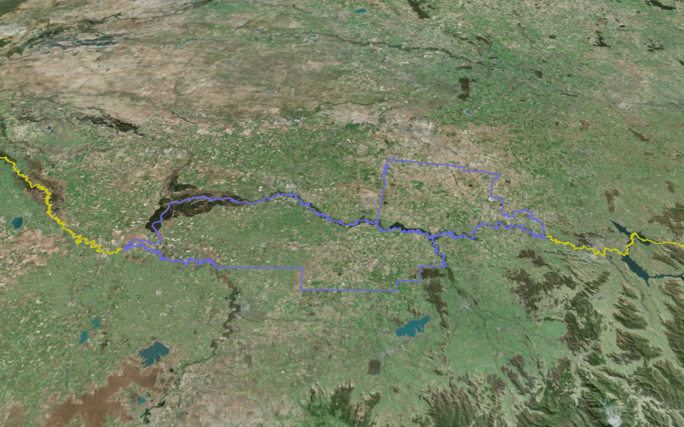
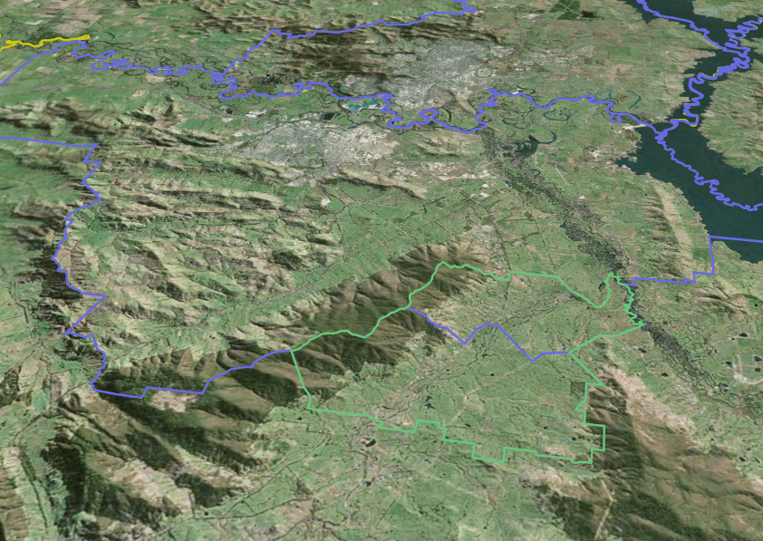
Spatial Relationship: Adjacency
Spatial Relationship: Intersection
STATE
(NSW)
LGA Y Corowa
LGA Albury
LGA X
Berrigan
SA2 Lavingtion
STATE
(VIC)

Slide 4
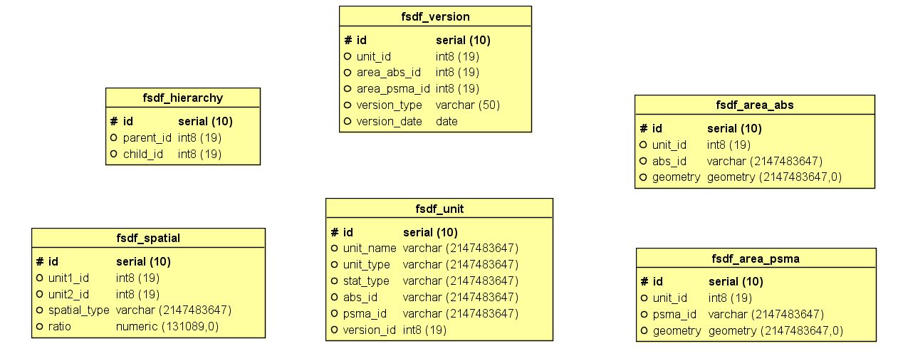

Slide 6
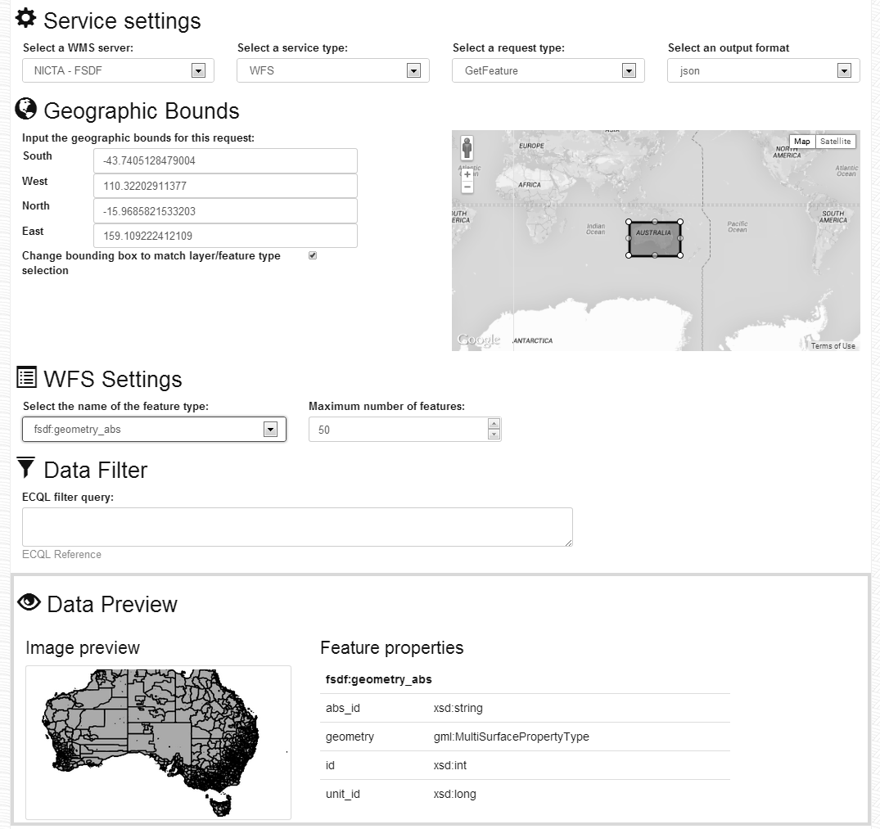
Server (e.g., FSDF)
Type (e.g., WFS)
Feature (e.g., FSDF_ABS)
Filter By Property (e.g., Unit_ID)

Slide 7
http://envirohack.research.nicta.com.au/[FSDF Server]/ows?service=[Service Type]&request=[Request Type]
&cql_filter=[Attribute Filter]&typeName=[Feature Type]&maxFeatures=[Max Features]&outputFormat=[Output Format]

